Slide 1
African Journal Partnership Project
Presentation to NIH IC Reps Fogarty International Center
September 20, 2011
Julia Royall Consultant, Global Health

Slide 3
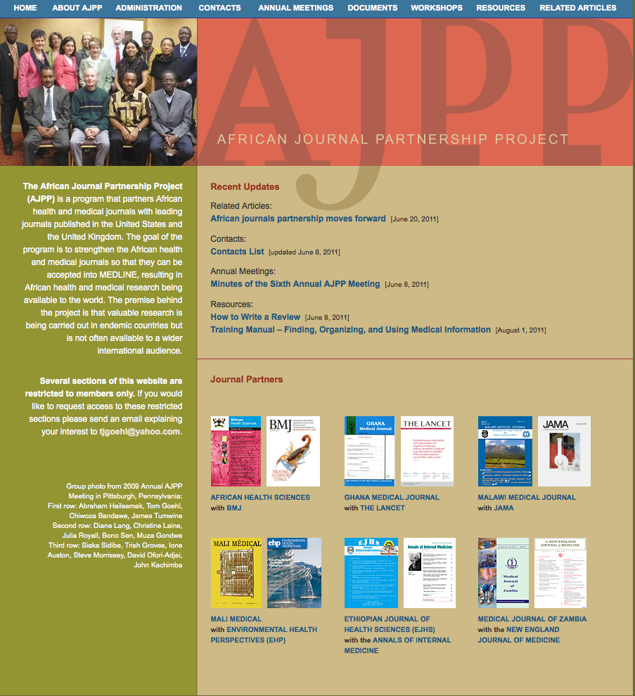
African Journal Partnership Project

Slide 4
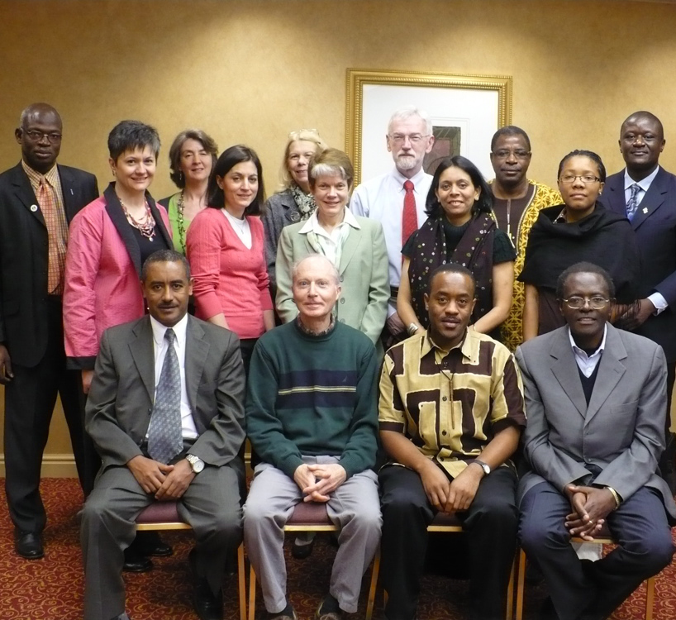
African Journal Partnership Project
6 African journals
6 journals from US and UK
Objective:
African journals get into Medline
Research carried out here available to international audience

Slide 5
Motivation
The National Library of Medicine (NLM), the Fogarty International Center (FIC), and the National Institute of Environmental Health Sciences (NIEHS), among others, recognized that valuable research being carried out in Africa is often not available on the continent itself let alone to the rest of the world.

Slide 6
History
NLM and FIC conceived the idea of fostering a health and medical journal capacity building program in Africa
Program initiated at meeting hosted by BMJ in 2003
Initially, four African journals were partnered with international journals
Importantly, African journal editors identified the journals’ needs to be addressed by partnerships
Formed two additional partnerships in 2008

Slide 7
Mission of AJPP
Promote publication excellence in African health & medical journals
Allow for wider dissemination of African research results

Slide 8
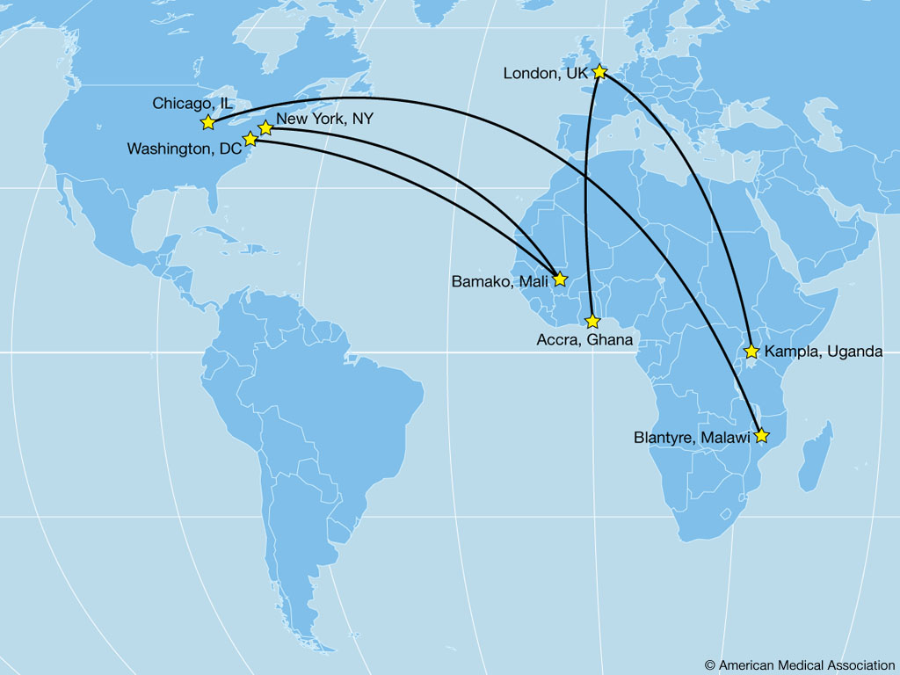
African Journal Partnership Project (AJPP)

Slide 9
Objectives
Facilitate the collaboration of African health and medical journal editors with counterparts in international journals
Improve the technical production capability of African journals
Support the training of writers, reviewers, and journalists
Encourage the editors in planning for succession and sustainability
Help journals earn acceptance for indexing into Medline and other major indexes

Slide 10
Funding
The initial contract was awarded for $109,000 (FY2004) with CSE as administrative contractor
Funding levels for subsequent years $100,000 (FY2005), $75,000 (FY2006), and $75,000 (FY 2007)
A second contract awarded for a five-year period in July 2008
Funding levels$150,000 (FY 2008); $210,000 (FY 2009 and FY 2010)

Slide 11
Leveraging Funding
Partnership has been successful in leveraging the FIC and NLM funds:
International journal partners
SPi Technologies
ScholarOne
WHO/TDR
CSE
Local contributions

Slide 12
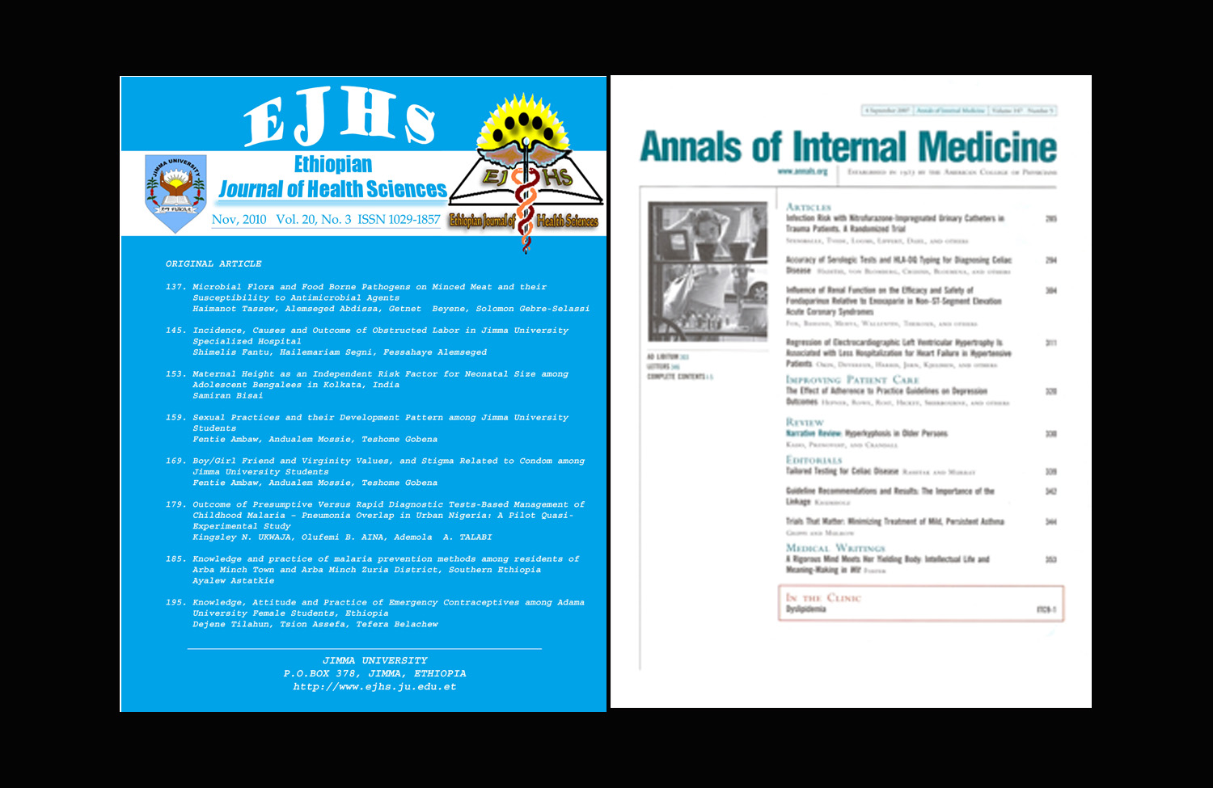
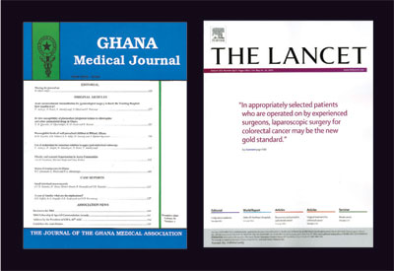
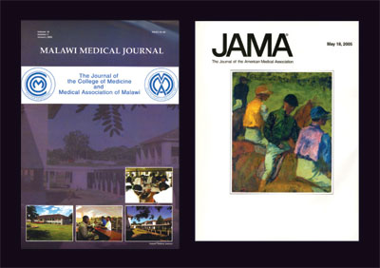
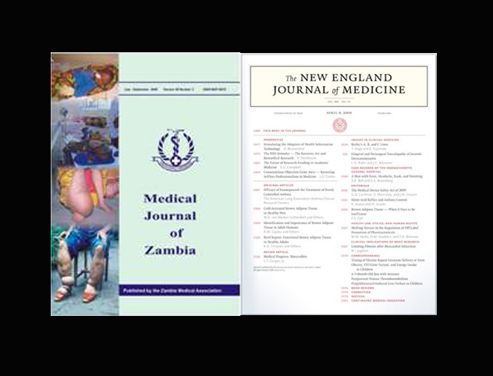
Partnerships

Slide 13
Journal Partnerships

Slide 14
Journal Partnerships

Slide 15
Journal Partnerships

Slide 16
Journal Partnerships

Slide 17
Journal Partnerships

Slide 18
Journal Partnerships

Slide 19
Participants (June 2011)

Slide 20
Participants (June 2011)
NLM
Ione Auston
Sheldon Kotzin
Carol J. Myers
Julia Royall
FIC
Linda E. Kupfer
NIEHS
Hui Hu
Mike Lo

Slide 21
Participants (June 2011)
African Journals Online
Lara Proud
American Osteopathic Association
Diane Berneath Lang
Council of Science Editors
David L. Stumph
CrossRef
Carol Anne Meyer
Kaufman-Wills Group, LLC
Cara S. Kaufman
ScholarOne
Paige Angle
George Kowal
Shawn Mollen
Isidora Rajsic
SPI Global Services
Karina C. Felizardo
Lyn Fuentes
Golda Galarce
Srinivasan K Govindarajan
Roda Narvaez
Virgil Sangalang
Thomson Reuters
Nancy Moebes
James Testa
University of Western Australia
Muza Gondwe
Consultant
Ruth Peyser

Slide 23
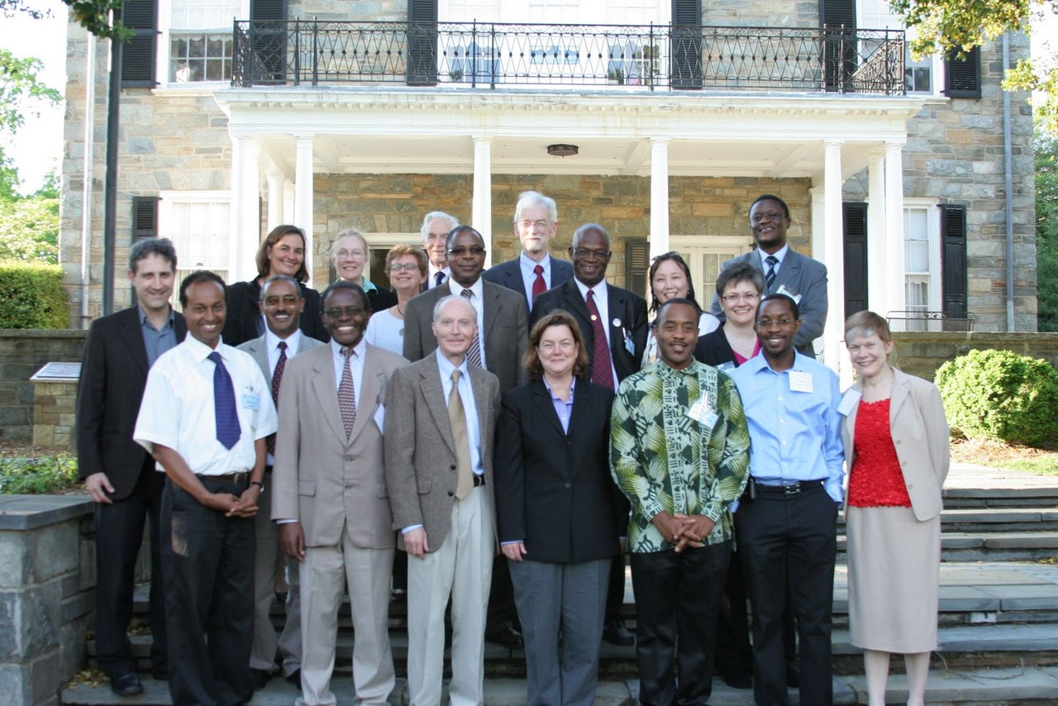
AJPP Meeting at NIH April 28-29 2011

Slide 24
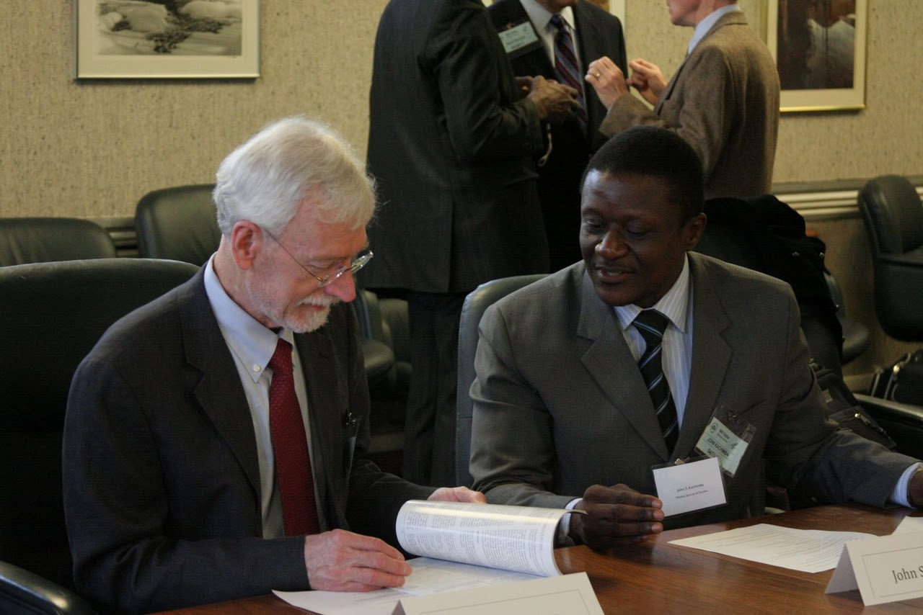
April 2011

Slide 25
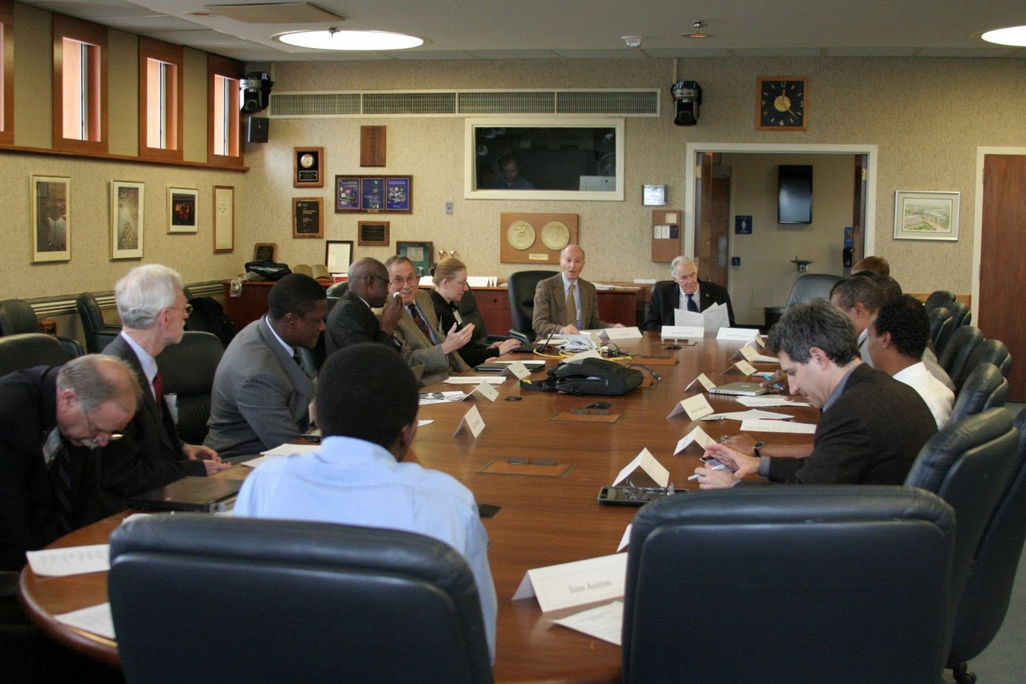
April 2011

Slide 26
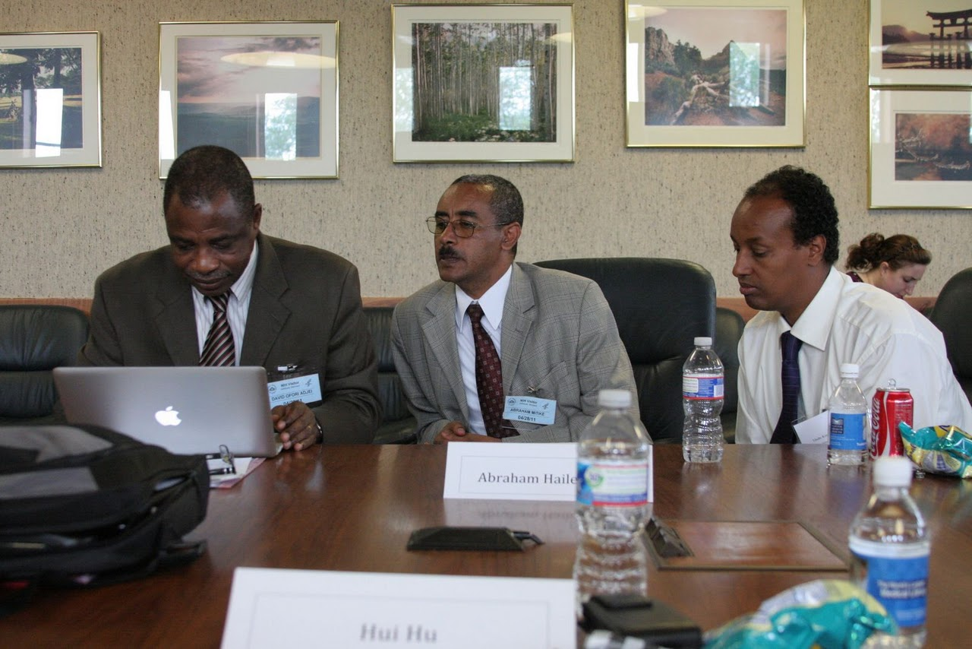
April 2011

Slide 27
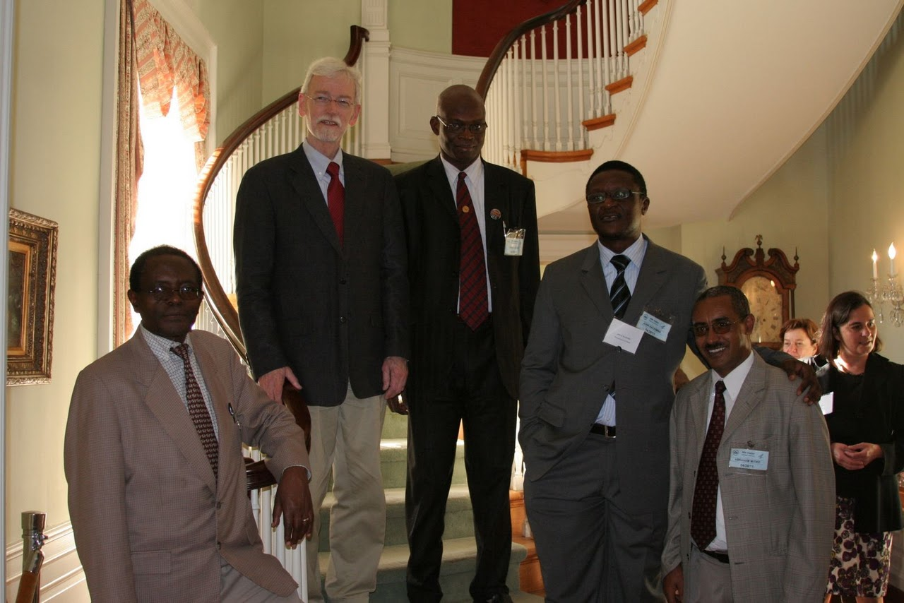
April 2011

Slide 28
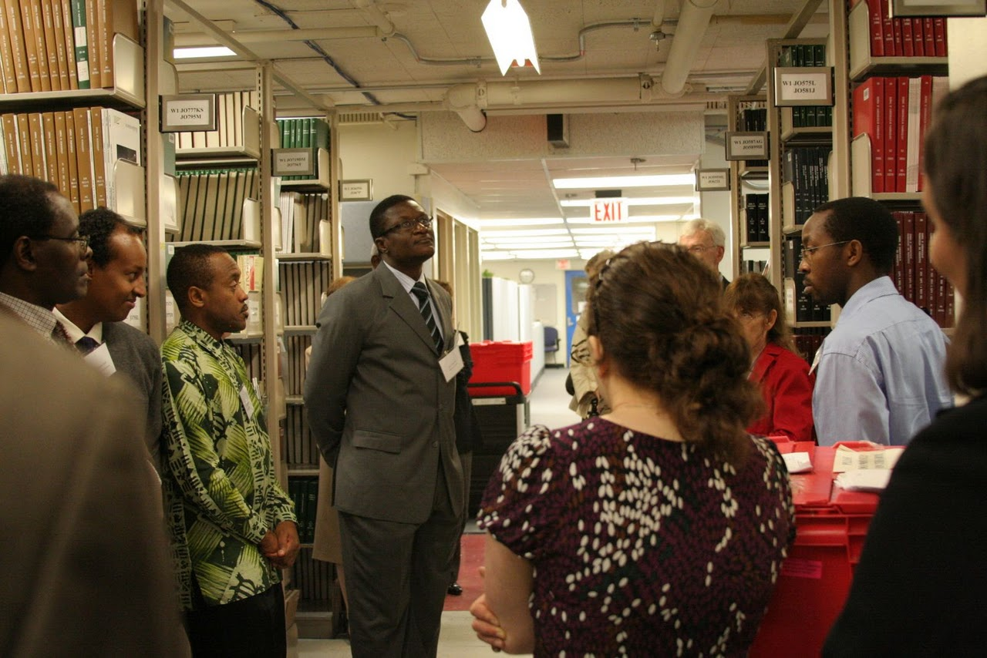
April 2011

Slide 29
Network of African Medical Librarians and Deans
Training Manual:Finding, Organizing, and Using Medical Information
Objectives:
Establish standards so that Information Literacy training is uniform in all health science schools on the African continent
Establish guidelines for Information Literacy training
Develop a self-instruction tool that can be used by both trainers and users

Slide 30
You Tube Videos "Finding, Organising, and Using Medical Information”
http://tinyurl.com/infomanual
Module | Presenter
Introduction, AHILA President | Nasra Gathoni
Module 1 Information Sources | Grace Ajuwon
Module 2 Searching Tools | Thembani Malapela
Module 3 Electronic Information Searching Techniques | Nancy Kamau
Module 4 Management of Information | Abda Anne
Module 5 Intellectual Property Rights | Christine Kanyengo
Module 6 Evaluation of Information | Abda Anne
Module 7 Scholarly Communication | Christine Kanyengo/Sara Mbaga
French version | Abda Anne
Portuguese version | Cristina Horta

Slide 31
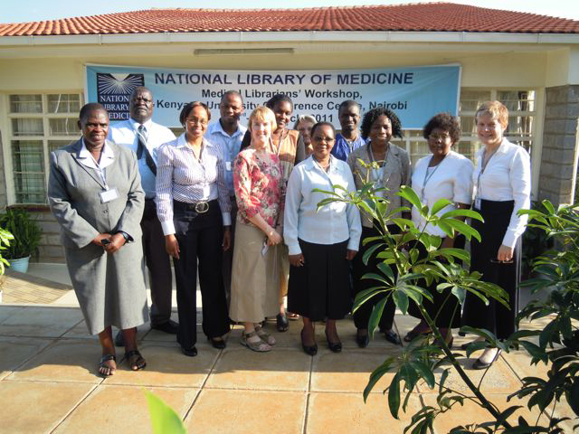
March 2011

Slide 32
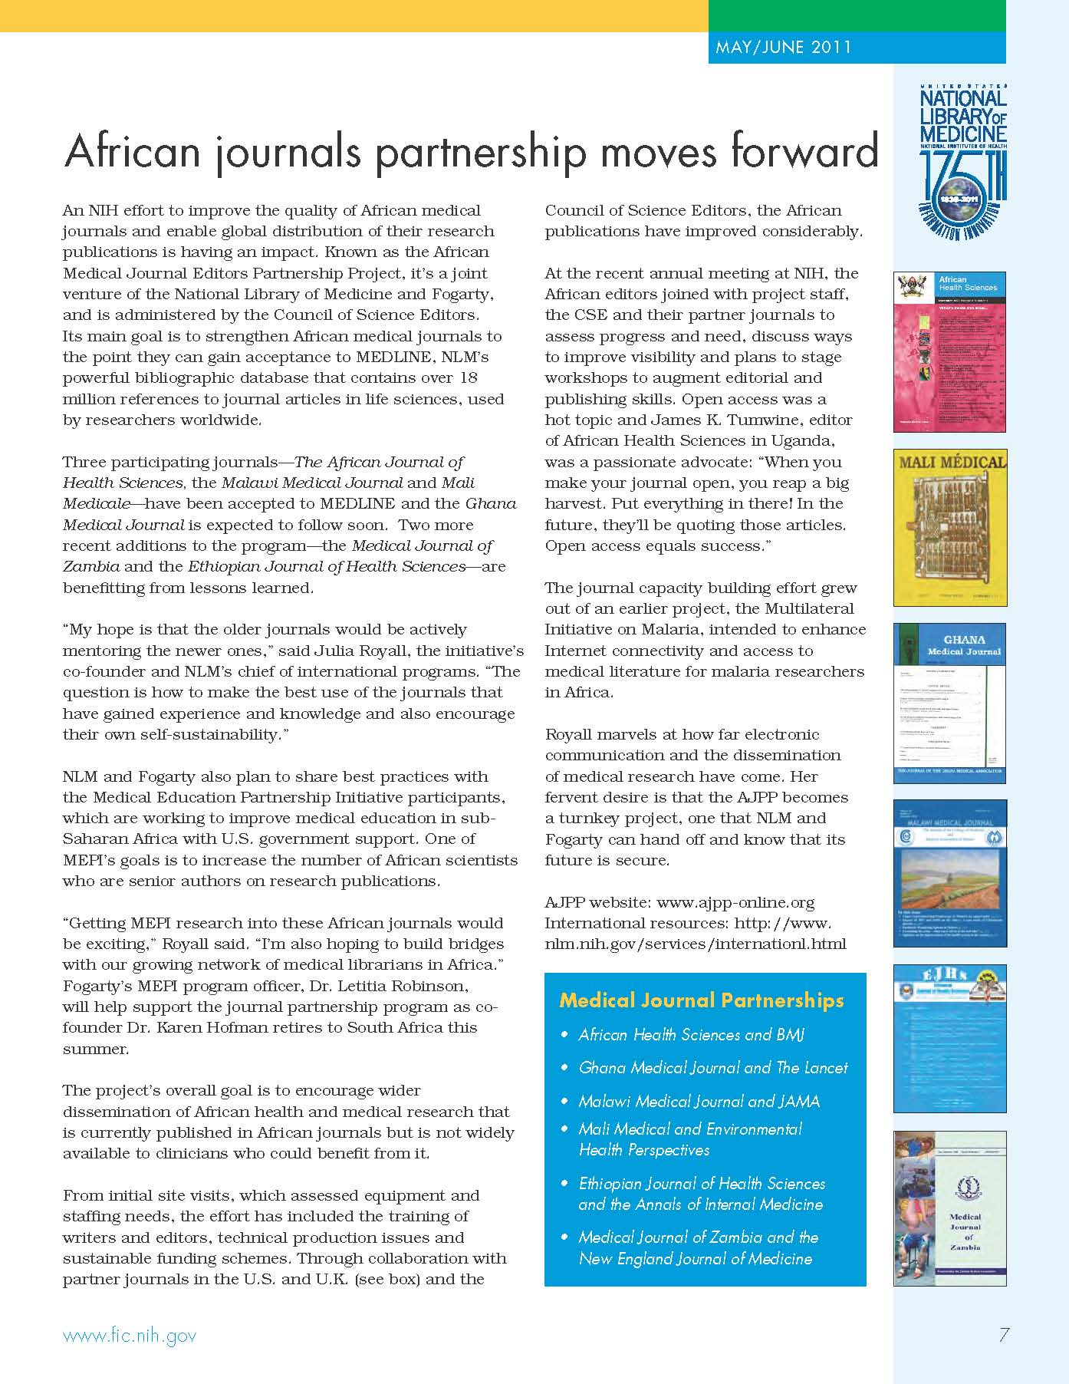

Slide 33
Journal Publication: African Journal of Health Sciences
Notes:
Debrief with COBES students and discussion re PRESENTATIONPAPER – African Health Sciences
JR meets with AHS editor – SLIDES OF TUMWINE and TEAM – they agree to train students in writing paper for medical journal

Slide 34
Journal Publication: African Journal of Health Sciences

Slide 35
Journal Publication: African Journal of Health Sciences

Slide 36
Journal Publication: African Journal of Health Sciences

Slide 37
Needs & Progress
Updated computer hardware and software plus initial training
All journals have received new hardware and software
All journals’ staff trained
Improving business plans and developing strategic plans for effective and sustainable publishing operations
Two workshops held

Slide 38
Needs & Progress (cont.)
Inadequate funds to support managing editors/business managers
Provided funds for all six journals

Slide 39
Needs & Progress (cont.)
Training in current state-of-art publication practices
Organizing workshops on how to manage a journal and peer review
Two workshops held on journal management
Six workshops held on peer review
Three journals trained in electronic submission and review systems
Journals participate in workshops at CSE annual meeting

Slide 40
Needs & Progress (cont.)
Improve electronic publication practices and visibility
Two workshops held
Three journals now using ScholarOne
All journals now have websites
All journals’ content converted to XML format for submission to PubMed Central

Slide 41
Needs and Progress (cont.)
Training for editors, clinicians and scientists on better communication techniques and improved journal visibility
One workshop held
Three journals now in Medline
Several journals now in EMBASE, Scopus, ISI, AJoL, Bioline, AIM, Google Scholar
All journal editors members of CSE

Slide 42
Needs & Progress (cont.)
Training for authors in statistics, data presentation, and data interpretation including how to use the NLM databases
Twelve workshops held
Establishing internships in the African journals’ editorial offices to mentor and train the next generation of editors
Internships established in five partner journals

Slide 43
Publications Success
Increase in manuscripts submitted
Decrease in acceptance rate
Decrease in average time from submission to publication
Increase in international submissions
Increase in the number of reviewers

Slide 44
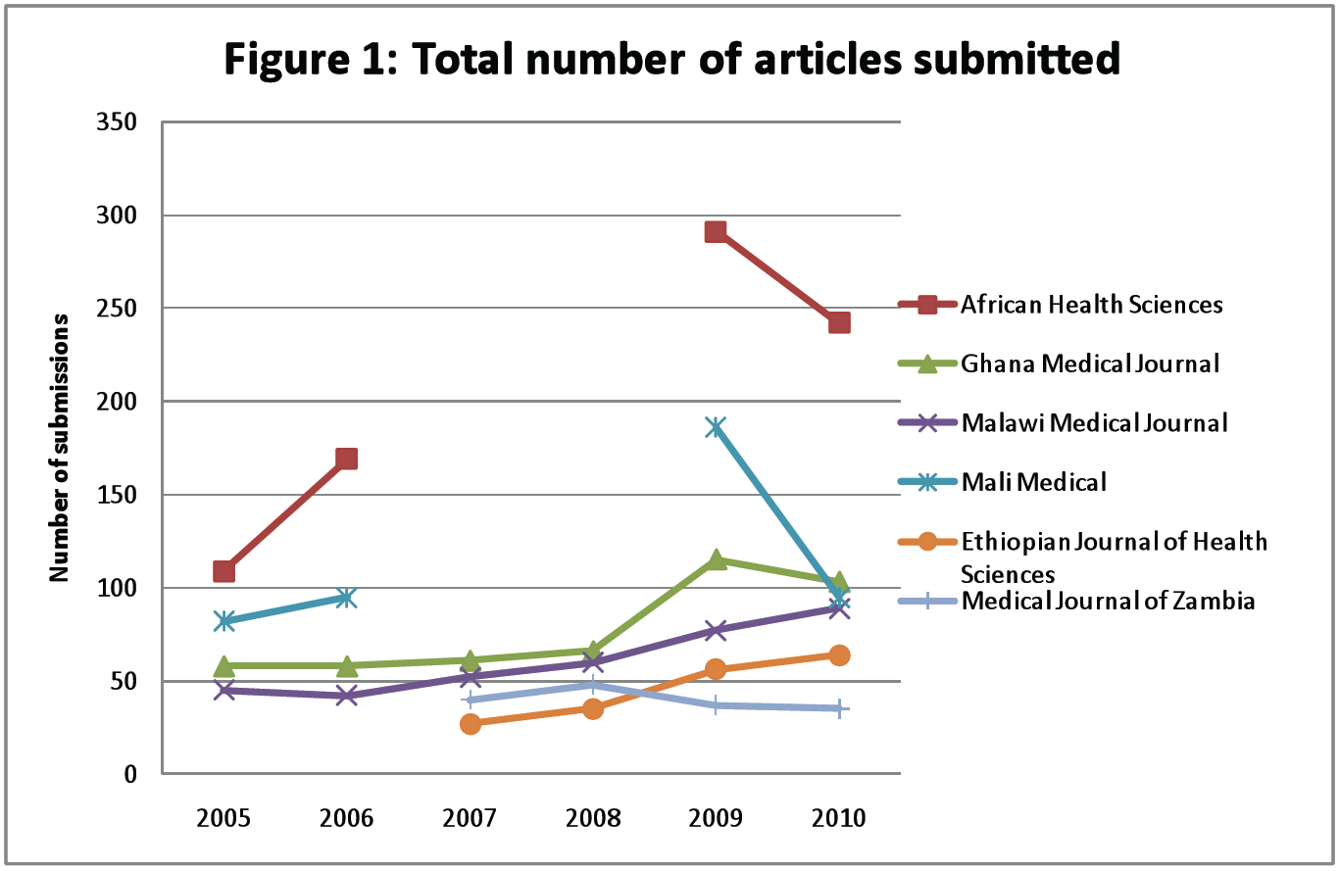

Slide 45
Open Access
James Tumwine:
“When you make your journal open, you reap a big harvest…put everything there. In the future, they'll be quoting those articles. Open Access equals success.”

Slide 46
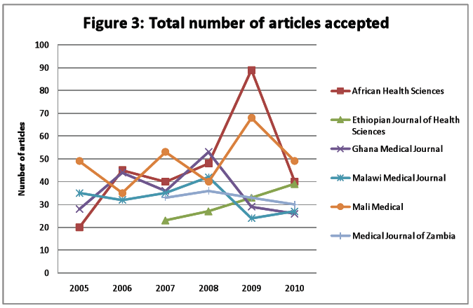

Slide 47
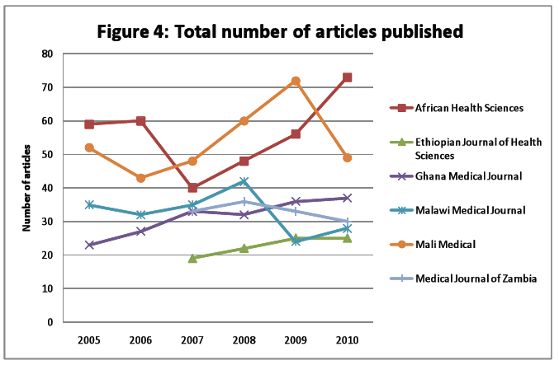

Slide 48
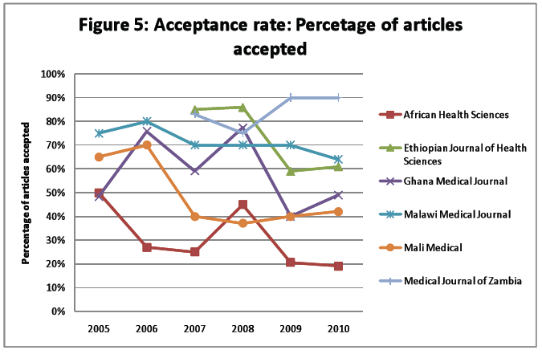

Slide 49
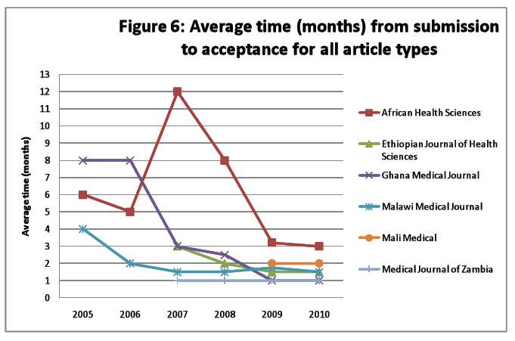

Slide 50
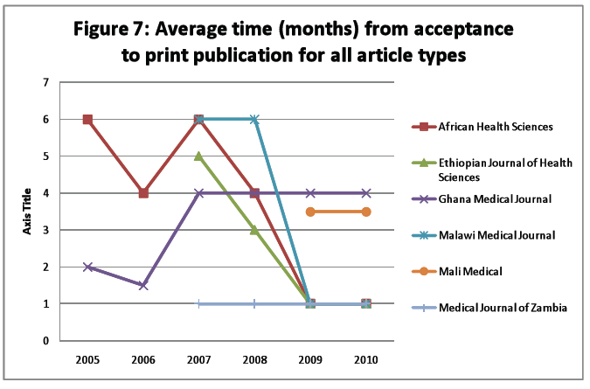

Slide 51
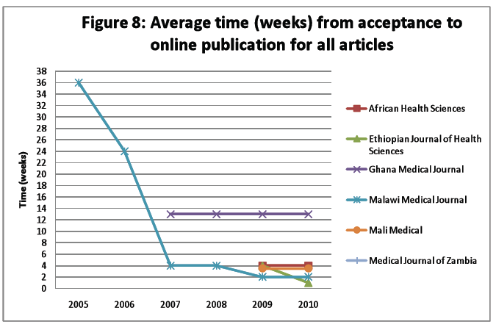

Slide 54
Conclusions
• Three of the four established journal partners are now indexed in Medline (AHS, MMJ, and MM), and two in PubMed Central (AHS and GMJ).
• Provision of new technical equipment and Manuscript Central software has enabled journals to become more efficient and resulted in significant improvements in processing times and journal management.
• XML conversions by SPi have also allowed journals to improve timeliness of publication.
• During AJPP, MM and MMJ have developed fully functional websites for their journals and are noticing increasing volume of traffic to these websites demonstrating improved visibility and ability to engage online readers.
• Performance indicators show that submissions have continued to increase, another indicator of improved visibility.

Slide 55
Conclusions (cont.)
Successful training workshops for authors and reviewers.
• Training a critical area of need in: writing review articles and case reports; e-publishing, enhancement of journal visibility, database searching, peer review workshops, data analysis, training in statistics, and publication ethics.
• Importance of conducting surveys with users (readers, authors, and reviewers).
• Greater focus on succession planning, training more editors and taking on interns.
• Editors have begun to optimally utilise the services of librarians, for example through engaging librarians as members of their editorial board (3 journals) and training researchers how to search databases. Consider utilising the NLM network of librarians in Africa (currently in Kenya, Mali, Mozambique, Nigeria, Uganda, Zambia, and Zimbabwe).

Slide 56
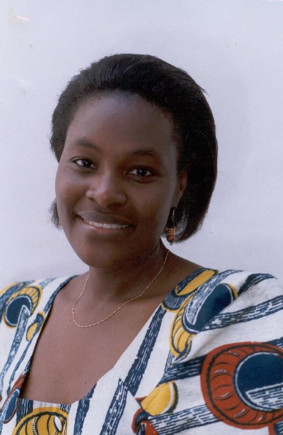
Christine Kanyengo, Zambia Medical Journal, University of Zambia

Slide 57
Sara Mbaga, African Health Sciences, Makerere University, Uganda

Slide 58
Lessons Learned
• Success driven by ability to leverage NIH funds, willingness of international journal partners to provide staff time and travel, support from other organisations including ScholarOne, SPi Services, and WHO/TDR, and major support from the Council of Science Editors.
But over and above this, strength has come from the African editors and their staff who with support above continue to make significant and sustainable achievements.
• Annual AJPP meetings, held in conjunction with annual meeting of Council of Science Editors, continue to be instrumental in fuelling enthusiasm to overcome barriers and in strengthening relationships amongst all partners.

Slide 59
Lessons Learned (cont.)
• Experience sharing amongst editors and AJPP journals continues to be constructive and has recently been useful for two new partner journals. AJPP journals are also now reaching out to other non-AJPP journals.
• Whilst progress was initially slow, there has been increased focus on succession plans to help sustain improvements in longer term. Editors training and involving new and younger staff.

Slide 60
Issues to Consider
The next generation of editors
Is internship the answer?
Quality of publications
Have we influenced this?
Everybody wants to be part of a success story
Survival: Which model works best?

Slide 61
Future Targets
• Common challenges still facing journals include manuscript quality, workflow, visibility, leadership succession, sustainability, language, printing, ePublishing and need to expand readership.
• Partners should continue to focus on succession plans for editors and should encourage even more involvement of younger interns and medical students.
• All partner journals should conduct user surveys with authors and reviewers to measure changing perceptions of journals and to determine visibility of journals.
• Whilst journals have been increasingly involving librarians in editorial boards and workshops with authors, it is important to continue this effort.
• Partners recognise need to educate and link with journalists to improve the translation of research from journals to multiple stakeholders. Possible workshops with journalists have been discussed, but there has been little progress.

Slide 62
Future Targets (cont.)
All partners pleased with opportunity to be involved are grateful for continued NIH funding and leadership and the support of the Council of Science Editors.
Established journal partners have managed to sustain improvements gained since start of project and have continued to show improvements in many directions.
New journal partners continue to learn from experience of established partners.
All partners working together enthusiastically and effectively and with continued support from the NIH and the Council of Science Editors, further progress toward accomplishing partnership goals is expected.

Slide 63
James Tumwine
“Take a bold step. Experiment! If you don't move with the world, it will leave you behind.”

